Slide 1
Progress Report
Information share on Bitcoin exchanges
2017
Financial Markets and Trading Laboratory
20175404 Rocku Oh

Slide 2
Top 10 Bitcoin exchanges
Exchange | Total_trade | Total_volume | VolumePerDay | VolumePerTrade | TradePerDay | First_date | Last_date
mtgoxUSD | 8295809 | 55575353.12 | 42294.79 | 51.740 | 6313.401 | 2010-07-17 23:09 | 2014-02-25 1:59
bitfinexUSD | 10182252 | 25730210.06 | 18975.08 | 2.517 | 7509.035 | 2013-03-31 22:07 | 2016-12-22 12:43
bitstampUSD | 12448193 | 20305460.20 | 9605.23 | 3.647 | 5888.455 | 2011-09-13 13:53 | 2017-07-17 22:23
btceUSD | 32601774 | 14911715.96 | 7083.95 | 2.901 | 15487.779 | 2011-08-14 14:14 | 2017-07-17 22:34
coinbaseUSD | 18192817 | 7500931.48 | 8100.36 | 0.436 | 19646.671 | 2014-12-01 5:33 | 2017-07-17 23:03
itbitUSD | 1345266 | 4333967.33 | 3193.79 | 5.107 | 991.353 | 2013-08-25 0:21 | 2017-08-30 22:02
lakeUSD | 3581917 | 2110627.84 | 4130.39 | 1.041 | 7009.622 | 2014-03-01 12:01 | 2017-07-05 10:56
localbtcUSD | 2702973 | 1976944.22 | 1210.62 | 1.176 | 1655.219 | 2013-03-11 23:57 | 2017-08-30 21:47
krakenUSD | 2314129 | 1355886.41 | 1093.46 | 0.642 | 1866.233 | 2014-01-07 18:18 | 2017-07-17 22:28
thUSD | 159159 | 1184918.03 | 4720.79 | 8.492 | 634.100 | 2011-06-08 20:12 | 2012-02-13 22:26
Financial Markets and Trading Laboratory

Slide 3
Hacking Issues on Bitcoin exchanges
Mt. Gox (2013. Aug)
The second hack as of February 2014 caused the company to go bankrupt. With 744,408 BTC missing for an unknown reason
Bitstamp(2015. Jan)
The losses amounted to 19,000 BTC or roughly $5.2 million at the time of the breach.
Bitfinex (2016. Aug)
In April 2017, Bitfinex announced that it was no longer able to let users withdraw their funds in USD
Financial Markets and Trading Laboratory

Slide 4
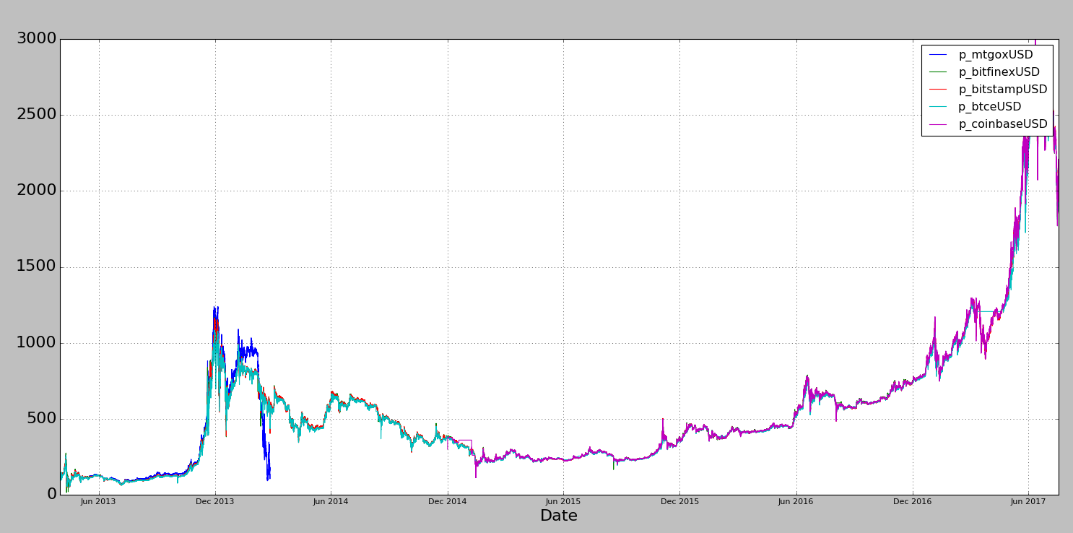
Hacking Issues on Bitcoin exchanges
Mt.Gox
Bitstamp
Bitfinex
Financial Markets and Trading Laboratory

Slide 5

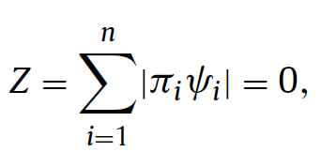
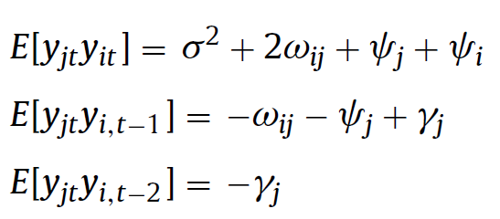
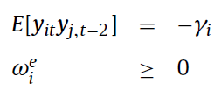
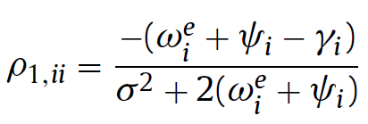
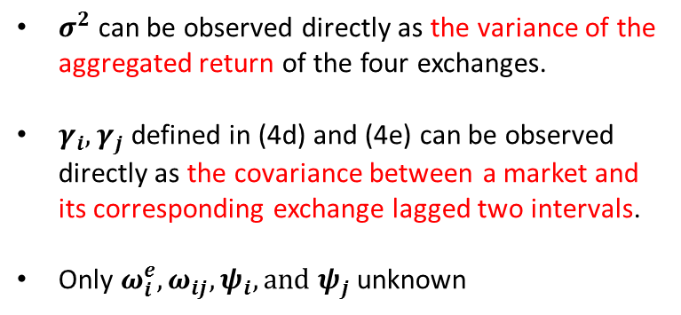
Information share
by Non-linear programming
with constraints and no objective function
Objective function
minimize
directed calculated
Constraints
$σ^{2}$ can be observed directly as the variance of the aggregated return of the four exchanges.
$γ_{i}, γ_{j}$ defined in (4d) and (4e) can be observed directly as the covariance between a market and its corresponding exchange lagged two intervals.
Only $ω_{i}^{e},ω_{ij}, ψ_{i}, and ψ_{j}$unknown
Manipulation data
Financial Markets and Trading Laboratory

Slide 6
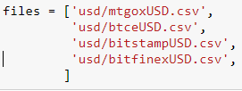
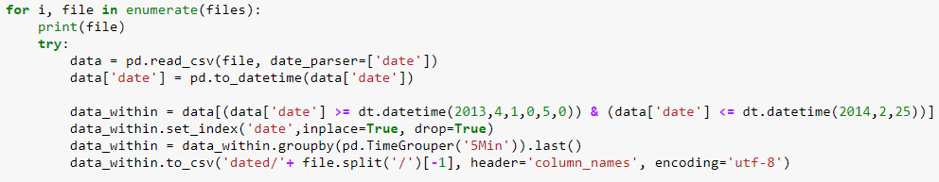
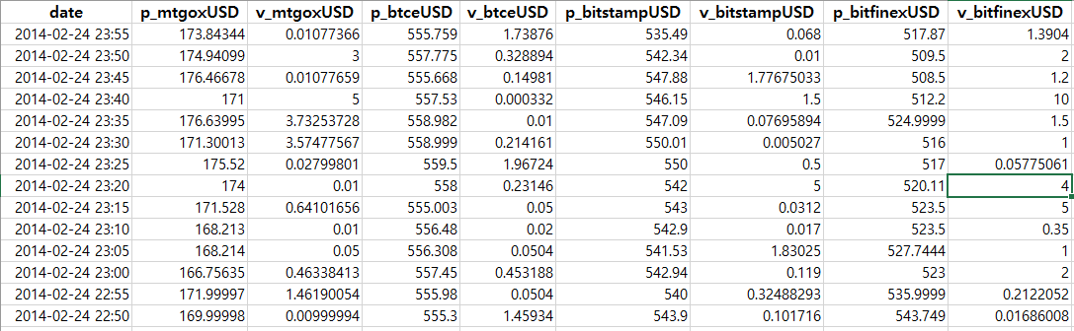
Paper replication
Step1. Create 5min-interval tick-data
Manipulation data
Financial Markets and Trading Laboratory

Slide 7
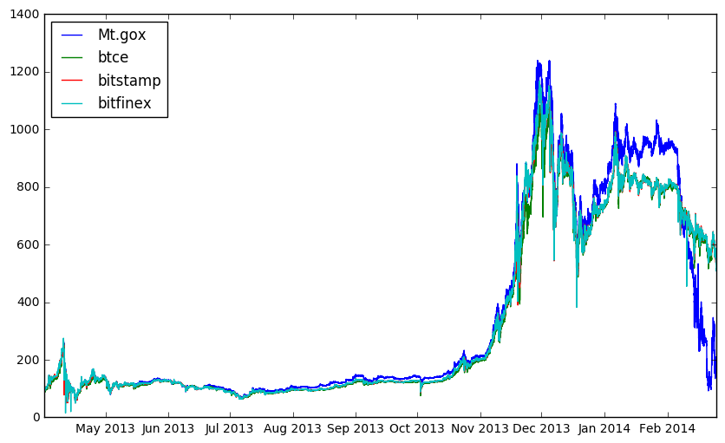
Paper replication
Step1. Create 5min-interval tick-data
USD pricebitcoin (5min-intverval)
Date
Manipulation data
Financial Markets and Trading Laboratory

Slide 8
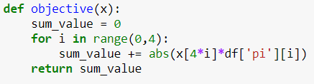
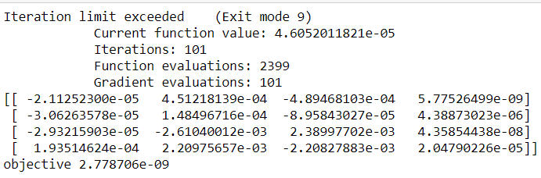


Paper replication
Step3. Calculate Non-linear programming with constraints
mtgox
btce
bitstamp
bitfinex
Manipulation data
Financial Markets and Trading Laboratory

Slide 9
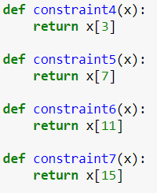
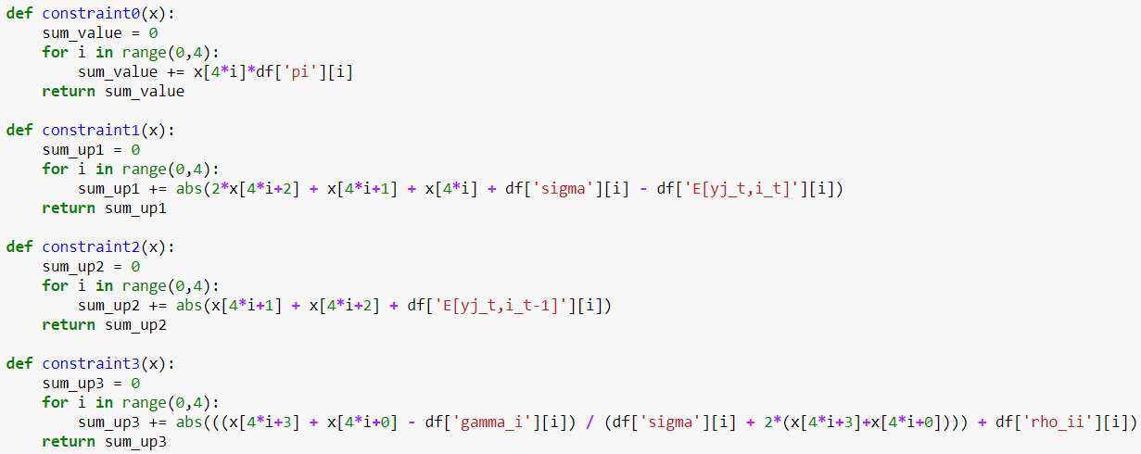
Paper replication
Step3. Calculate Non-linear programming with constraints
Manipulation data
Financial Markets and Trading Laboratory

Slide 10
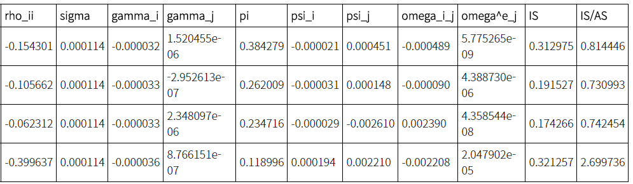

Paper replication
Step3. Calculate
mtgox
btce
bitstamp
bitfinex
Mt.Gox has got an information share of 0.313, meaning that 31.3% of all the information in the market comes from this exchange.
Manipulation data
Financial Markets and Trading Laboratory

Slide 11
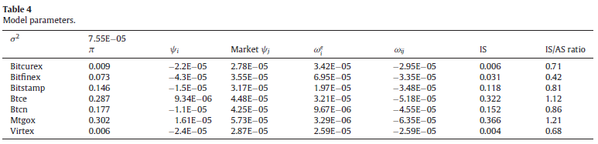
Paper replication
Comparison of original results
mtgox
btce
bitstamp
bitfinex
Manipulation data
Financial Markets and Trading Laboratory

Slide 12
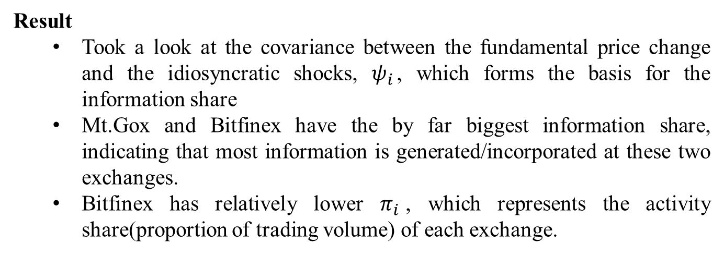
Paper replication
Result
Took a look at the covariance between the fundamental price change and the idiosyncratic shocks, $ψ_{i}$, which forms the basis for the information share
Mt.Gox and Bitfinex have the by far biggest information share, indicating that most information is generated/incorporated at these two exchanges.
Bitfinex has relatively lower $π_{i}$, which represents the activity share(proportion of trading volume) of each exchange.
mtgox
btce
bitstamp
bitfinex
Manipulation data
Financial Markets and Trading Laboratory

Slide 13
Mt. Gox (August, 2013)
Information share (2013.04 ~2014.02)
(hacking) announcement
Collapse
Financial Markets and Trading Laboratory

Slide 14
Mt. Gox (August, 2013)
Roll’s measure (2013.04 ~2014.02)
(hacking) announcement
Collapse
Financial Markets and Trading Laboratory

Slide 15
Bitstamp (Jan., 2015)
Information share (2014.08 ~2015.06)
(hacking) announcement
Financial Markets and Trading Laboratory

Slide 16
Bitstamp (Jan., 2015)
Roll’s measure (2014.08 ~2015.06)
(hacking) announcement
Financial Markets and Trading Laboratory

Slide 17
Bitfinex (August, 2016)
Information share (2016.02 ~2016.12)
(hacking) announcement
Collapse
Financial Markets and Trading Laboratory

Slide 18
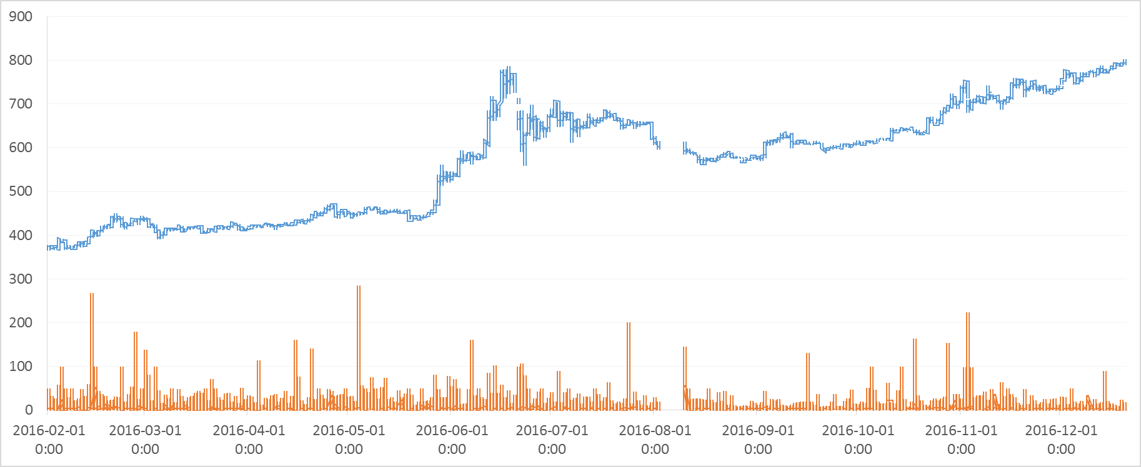
Bitfinex (August, 2016)
Roll’s measure (2016.02 ~2016.12)
(hacking) announcement
Collapse
Financial Markets and Trading Laboratory

Slide 19
Bitstamp (Jan. 5. 2015)
2014.12.21 ~2015.01.19
Exchange | Mean_Before | Mean_After | T-statistic | P-value
bitstampUSD | 0.181 | 0.218 | -3.347 | 0.003
bitfinex | 0.276 | 0.262 | 1.172 | 0.252
btce | 0.173 | 0.212 | -2.773 | 0.010
lakebtc | 0.368 | 0.305 | 4.309 | 0.0002
localbtc | 0.002 | 0.003 | -2.045 | 0.051
Announced
Hasbrouck’s IS
Financial Markets and Trading Laboratory

Slide 20
Bitfinex (August. 2. 2016)
2016.07.16 ~2016.08.16
Exchange | Mean_Before | Mean_After | T-statistic | P-value
bitstamp | 0.138 | 0.122 | 1.449 | 0.161
bitfinex | 0.263 | 0.228 | 1.454 | 0.160
btce | 0.091 | 0.232 | -10.880 | 0.000
coinbase | 0.355 | 0.290 | 1.970 | 0.062
localbtc | 0.0007 | 0.0006 | 1.260 | 0.221
cex | 0.152 | 0.127 | 1.930 | 0.067
Announced
Hasbrouck’s IS
Financial Markets and Trading Laboratory

Slide 21
Analysis
Hacked : Bitfinex and Bitstamp + mtgox + coincheck+ yobit
Baseline = -7 day
Interval = -6 ~ +6 day
Diff IS = IS – event day IS by exchanges
Announced
Average Diff IS
Trading day
Financial Markets and Trading Laboratory

Slide 22
Causality
Does the hacking issue affect the information share ?
Other effects
Impact on information share and liquidity when exchange shut down and collapse
Lead-lag analysis
which exchange is leader (follower)?
Financial Markets and Trading Laboratory

